Slide 1
Pharmaceutical and medical supplies
B2B Business Process Flows

Slide 2








Systems architecture and personas
RDBMS
Front Store App
Cloud SQL
Inventory Service
OR
Institutional Purchaser or Retailer
Doc. DBMS
Front-end
Authentication Service
Fire store
Cloud Run
Pub/Sub
Back Store App
Data warehouse
Order Service
Supplier or Manufacturer
Static Images
BigQuery
Logging & Tracing
Location Service
Cloud Storage
Cloud Logging

Slide 3
User registration and commercial account
New User Registration / Sign-in
User ID, Name, Email, Phone No.
End User
Create Commercial Account
Secure Your Account
Create/Maintain Commercial Account
Company Name, Industry, Primary Business, Role
Two Factor Authentication & Recovery Setup
2FA (Google), Recovery Code, Question, Email
Maintain/Update Buyer Information
Buyer User, Budget limit, Level, Approval
Determines Company Executive’s Role as a Buyer (Front Store) or Seller (Back Store) or Both.
Share Your Account
Maintain/Update Commercial Information
Sales User(s), Segment, Region
Share Your Account
With other employee(s), Vendor(s)

Slide 4
Purchasing process – user searches & orders
Purchasing by Institutional Buyer or Retailer from enlisted Supplier(s)
Front-Store App
Free Text Search
Product Search
Engine
Location
Engine
Custom Home Page
Shopping Cart
Item Details, Order Summary, Promos/Offers, Licenses
Wish List
Order Summary, Logistics info. Order Invoice, Payment Receipt
Highlights
New Products/Deals, Current Orders, Alternatives
Recommendation
Products, Suppliers, Manufacturers
Navigational Search
Product Details
Price, Availability, Specs, Desc., Image, Components, Service Info., Cart Summary
Check-out
Cart Summary, Shipping & Billing Address, Payment Methods
Search Results
Buyer User
Location
User Entry/ Auto-Detect
Store Locator
Store Locator
Post Requirement
Product/Product Type, Quantity, Price Range, Location of Fulfillment, RFQ
Order
Order Summary, Logistics info. Order Invoice, Payment Receipt
Buyer’s Page
Recommends, Current PO, Stock Sourcing Update, BP, Deals, PO Responses, Quotations, Add to Cart
Catalog/Product List
Segment/Vendor/Manufacturer/Price/Spec. wise listing, filtration and sorting, Add to Cart
Delivery Mgmt.
Logistics
3rd Party
Back-Store App
Stock Availability
Engine
Product Stock
Inventory Info, Vendor Stock, Souring Availability
Order Confirm Incoming/Outbound Order Details incl. item quantities, selling/buying/quoted prices, Delivery Dates, Stock Info, Logistics, Invoicing & Payment Terms, Stock Reservation
Sourcing & Procurement
Inventory Maint.
Subcontracting
Payment
Customer/Vendor Payments, Monthly/Quarterly Statement, Penalties, Discounts, Refunds
Product Catalog
Update MFG/Supplier-wise Product Price, Specs, Desc., Images, Comps, Warranties
Invoice Verify
Incoming Delivery, Quality Mgmt., Invoice, Payment Terms, Returns & Refunds
Supplier
Order Mgmt. Incoming/Outbound Order Fulfillment, Pricing, Delivery Scheduling, Logistics info., Invoicing & Payment Terms, Penalties, Returns & Refunds
Billing
Outbound Delivery Confirm, Bill with Payment Terms, Discounts, Penalties

Slide 5
Sourcing and procurement process
Procurement by Supplier from manufacturers and stockiest (Vendor hereafter)
Front-Store App
Could DB
Procure. Plan
Meet-to-stock/Demand, Stock Avail., Proc. Req., Vendors
Order Confirm
Quote Conf.
Purchase Order
Invoice Verification
Buyer’s Page
Recommends, Current PO, Stock Sourcing Update, BP, Deals, Order Responses, Quotations, Add to Cart
Good Receipt
Invite Quote.
Open/Private/Selective RFQ
Payment Sch.
3rd Party
Logistics
Delivery Mgmt.
Back-Store App
Could DB
Product Stock
Internal Stock
Partner Stock
Seller’s Page
Recommends, Current PO, Stock Sourcing Update, BP, Deals, Quote Responses, Invoice/Billing Updates, Summary
Payment Upd.
Sourcing Stock
Goods Packaging
Vendor Catalog
Vendor Pers. & Comm. Info, Product Catalog & Stock Info.
Partner/Pref. Ven.
Quote Req.
RFQ Response
PO Confirm
Invoice
Gen. Vendor/Sup.

Slide 6
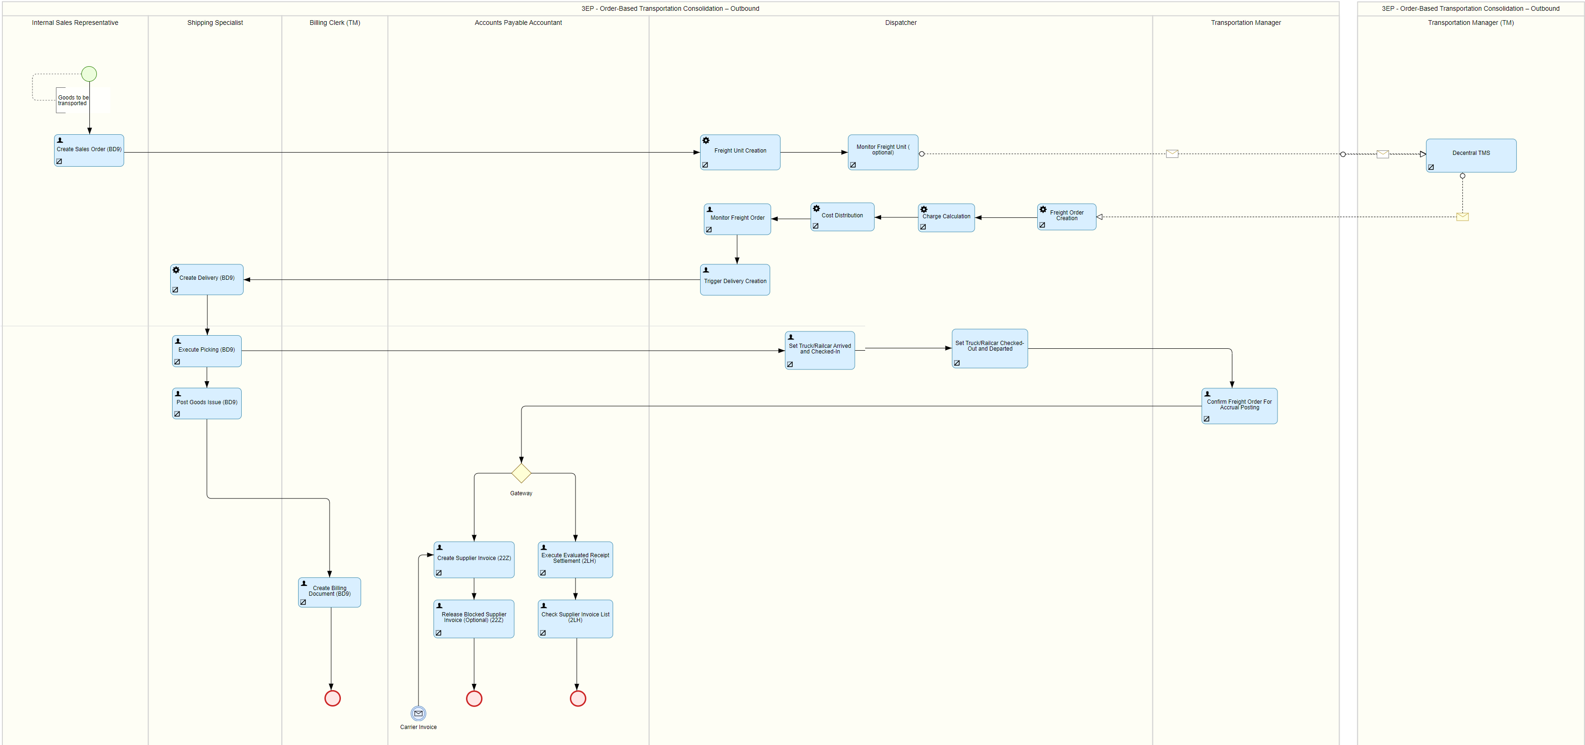
Delivery and transportation process

